Slide 1
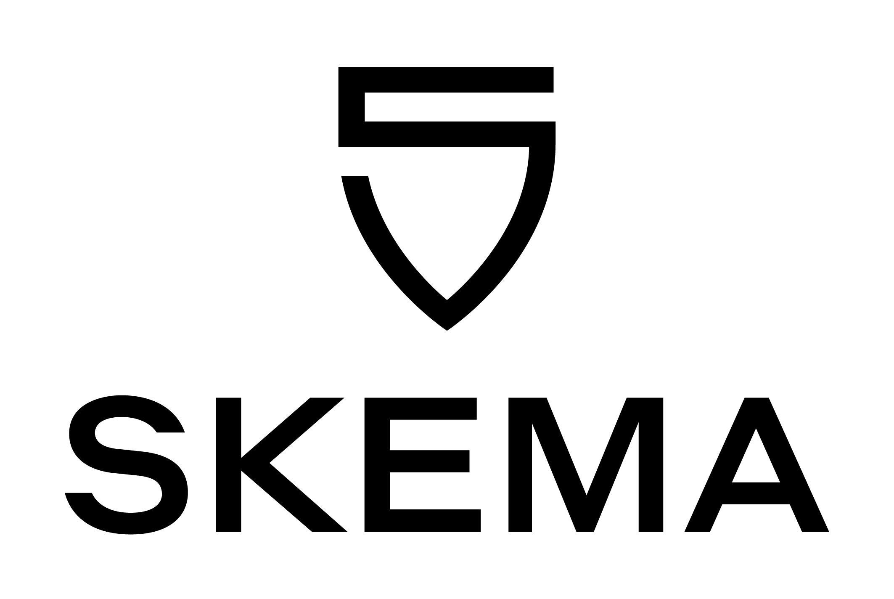
Capital Budgeting
Msc Corporate Financial Management
Lille Campus - 18 hours
Skema Business School
Step 4A: Understand role of capital structure on capital budgeting
"Capital Structure in a Perfect Market"
Pr. Sébastien DEREEPER
Sebastien.Dereeper@skema.edu
Course Based on :
J. Berk & P. De Marzo - Corporate Finance - Pearson, 2024
Notes:
If this PowerPoint presentation contains mathematical equations, you may need to check that your computer has the following installed:
1) Math Type Plugin
2) Math Player (free versions available)
3) NVDA Reader (free versions available)

Slide 2
Outline
1 Equity Versus Debt Financing
2 Modigliani–Miller
Leverage, Arbitrage, and Firm Value
3 Modigliani–Miller
Leverage, Risk, and the Cost of
Capital
4 Capital Structure Fallacies
5 M M: Beyond the Propositions

Slide 3
Learning Objectives (1 of 4)
Define the types of securities usually used by firms to raise capital; define leverage.
Describe the capital structure that the firm should choose.
List the three conditions that make capital markets perfect.

Slide 4
Learning Objectives (2 of 4)
Discuss the implications of M M Proposition
and the
roles of homemade leverage and the Law of One Price in the development of the proposition.
Calculate the cost of capital for levered equity according to
M M Proposition
Illustrate the effect of a change in debt on weighted average cost of capital in perfect capital markets.

Slide 5
Learning Objectives (3 of 4)
Calculate the market risk of a firm’s assets using its unlevered beta.
Illustrate the effect of increased leverage on the beta of a firm’s equity.
Compute a firm’s net debt.
Discuss the effect of leverage on a firm’s expected earnings per share.

Slide 6
Learning Objectives (4 of 4)
Show the effect of dilution on equity value.
Explain why perfect capital markets neither create nor destroy value.

Slide 7
1 Equity Versus Debt Financing
Capital Structure
  The relative proportions of debt, equity, and other securities that a firm has outstanding

Slide 8
Financing a Firm with Equity (1 of 6)
You are considering an investment opportunity
  For an initial investment of $800 this year, the project will generate cash flows of either $1400 or $900 next year, depending on whether the economy is strong or weak, respectively
  Both scenarios are equally likely

Slide 9
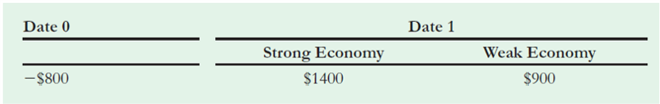
Table 1
The Project Cash Flows
Notes:
Long Description:
The table headers are date 0: initial investment and date 1: strong economy and weak economy. The data listed row-wise are as follows: negative 800 dollars, 1400 dollars, 900 dollars.

Slide 10
Financing a Firm with Equity (2 of 6)
The project cash flows depend on the overall economy and thus contain market risk
  As a result, you demand a 10% risk premium over the current risk-free interest rate of 5% to invest in this project
What is the N P V of this investment opportunity?

Slide 11
Financing a Firm with Equity (3 of 6)
The cost of capital for this project is 15%. The expected cash flow in one year is
The NPV of the project is

Slide 12
Financing a Firm with Equity (4 of 6)
If you finance this project using only equity, how much would you be willing to pay for the project?
  If you can raise $1000 by selling equity in the firm, after paying the investment cost of $800, you can keep the remaining $200, the N P V of the project N P V, as a profit

Slide 13
Financing a Firm with Equity (5 of 6)
Unlevered Equity
  Equity in a firm with no debt
Because there is no debt, the cash flows of the unlevered equity are equal to those of the project

Slide 14
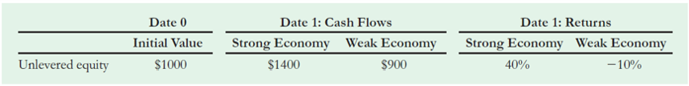
Table 2
Cash Flows and Returns for Unlevered Equity
Notes:
Long Description:
The table headers are Date 0: Initial Value, Date 1: cash flows (strong economy and weak economy), date 1: returns (strong economy and weak economy). The data listed row-wise are as follows: Unlevered equity, 1000 dollars, 1400 dollars, 900 dollars, 40 percent, negative 10 percent.

Slide 15
Financing a Firm with Equity (6 of 6)
Shareholder’s returns are either 40% or 10%
  Because the cost of capital of the project is 15%, shareholders are earning an appropriate return for the risk they are taking

Slide 16
Financing a Firm with Debt and Equity (1 of 6)
Suppose you decide to borrow $500 initially, in addition to selling equity
  Because the project’s cash flow will always be enough to repay the debt, the debt is risk free, and you can borrow at the risk-free interest rate of 5%
    You will owe the debt holders
    in one year.
Levered Equity
  Equity in a firm that also has debt outstanding

Slide 17
Financing a Firm with Debt and Equity (2 of 6)
Given the firm’s $525 debt obligation, your shareholders will receive only:
if the economy is strong and
if the economy is weak

Slide 18
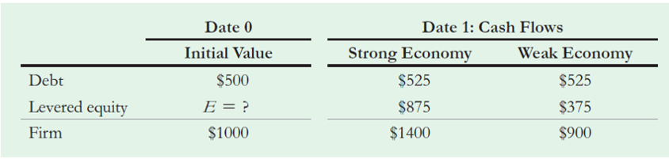
Table 3
Values and Cash Flows for Debt and Equity of the Levered Firm
Notes:
Long Description:
The table headers are Date 0: initial value and date 1: cash flow (strong economy and weak economy). The data listed row-wise are as follows: debt, 500 dollars, 525 dollars, 525 dollars; levered equity, E equals question mark, 875 dollars, 375 dollars; firm, 1000 dollars, 1400 dollars, 900 dollars.

Slide 19
Financing a Firm with Debt and Equity (3 of 6)
What price E should the levered equity sell for?
Which is the best capital structure choice for the entrepreneur?

Slide 20
Financing a Firm with Debt and Equity (4 of 6)
Modigliani and Miller argued that with perfect capital markets, the total value of a firm should not depend on its capital structure
  They reasoned that the firm’s total cash flows still equal the cash flows of the project and, therefore, have the same present value

Slide 21
Financing a Firm with Debt and Equity (5 of 6)
Because the cash flows of the debt and equity sum to the cash flows of the project, by the Law of One Price the combined values of debt and equity must be $1000
  Therefore, if the value of the debt is $500, the value of the levered equity must be $500

Slide 22
Financing a Firm with Debt and Equity (6 of 6)
Because the cash flows of levered equity are smaller than those of unlevered equity, levered equity will sell for a lower price ($500 versus $1000)
  However, you are not worse off
  You will still raise a total of $1000 by issuing both debt and levered equity
  Consequently, you would be indifferent between these two choices for the firm’s capital structure

Slide 23
The Effect of Leverage on Risk and Return (1 of 6)
Leverage increases the risk of the equity of a firm
  Therefore, it is inappropriate to discount the cash flows of levered equity at the same discount rate of 15% that you used for unlevered equity. Investors in levered equity will require a higher expected return to compensate for the increased risk

Slide 24
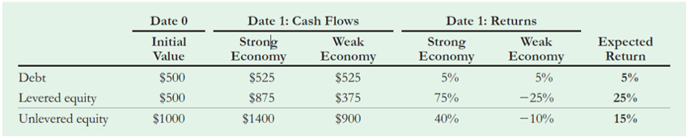
Table 4
Returns to Equity with and without Leverage
Notes:
Long Description:
The table headers are date 0 (initial value), date 1: cash flows (strong economy and weak economy), date 1: returns (strong economy and weak economy), and expected return. The data listed row-wise are as follows: debt, 500 dollars, 525 dollars, 525 dollars, 5 percent, 5 percent, 5 percent; levered equity, 500 dollars, 875 dollars, 375 dollars, 75 percent, negative 25 percent, 25 percent; unlevered equity, 1000 dollars, 1400 dollars, 900 dollars, 40 percent, negative 10 percent, 15 percent.

Slide 25
The Effect of Leverage on Risk and Return (2 of 6)
The returns to equity holders are very different with and without leverage
  Unlevered equity has a return of either 40% or -10%, for an expected return of 15%
  Levered equity has higher risk, with a return of either 75% or -25%
    To compensate for this risk, levered equity holders receive a higher expected return of 25%

Slide 26
The Effect of Leverage on Risk and Return (3 of 6)
The relationship between risk and return can be evaluated more formally by computing the sensitivity of each security’s return to the systematic risk of the economy

Slide 27
Table 5
Systematic Risk and Risk Premiums for Debt, Unlevered Equity, and Levered Equity
Blank | Return Sensitivity (Systematic Risk) | Risk premium
Blank | Delta R equals R left parenthesis strong right parenthesis minus R left parenthesis weak right parenthesis. | Upper E left bracket upper R right bracket minus r subscript f.
Debt | 5 percent minus 5 percent equals 0 percent. | 5 percent minus 5 percent equals 0 percent.
Unlevered equity | 40 percent minus left parenthesis negative 10 percent right parenthesis equals 50 percent. | 15 percent minus 5 percent equals 10 percent.
Levered equity | 75 percent minus left parenthesis negative 25 percent right parenthesis equals 100 percent. | 25 percent minus 5 percent equals 20 percent.

Slide 28
The Effect of Leverage on Risk and Return (4 of 6)
Because the debt’s return bears no systematic risk, its risk premium is zero
In this particular case, the levered equity has twice the systematic risk of the unlevered equity and, as a result, has twice the risk premium

Slide 29
The Effect of Leverage on Risk and Return (5 of 6)
In summary,
  In the case of perfect capital markets, if the firm is 100% equity financed, the equity holders will require a 15% expected return
  If the firm is financed 50% with debt and 50% with equity, the debt holders will receive a return of 5%, while the levered equity holders will require an expected return of 25% (because of their increased risk)

Slide 30
The Effect of Leverage on Risk and Return (6 of 6)
In summary,
  Leverage increases the risk of equity even when there is no risk that the firm will default
    Thus, while debt may be cheaper, its use raises the cost of capital for equity. Considering both sources of capital together, the firm’s average cost of capital with leverage is the same as for the unlevered firm

Slide 31
Example 1 (1 of 2)
Leverage and the Equity Cost of Capital
Problem
  Suppose the entrepreneur borrows only $200 when financing the project. According to Modigliani and miller, what should the value of the equity be? What is the expected return?

Slide 32
Example 1 (2 of 2)
Because the value of the firm’s total cash flows is still $1000, if the firm
borrows $200, its equity will be worth $800. the firm will owe
in one year. Thus, if the economy is strong, equity holders will receive
for a return of
If the economy is strong, equity holders will receive
for a return of
The equity has an expected return of
  Note that the equity has a return sensitivity of
  which is
  of the sensitivity of unlevered equity. Its risk
  premium is
  which is also 125% of the risk premium
  of the unlevered equity so it is appropriate compensation for the risk.

Slide 33
2 Modigliani-Miller : Leverage, Arbitrage, and Firm Value (1 of 3)
The Law of One Price implies that leverage will not affect the total value of the firm
  Instead, it merely changes the allocation of cash flows between debt and equity, without altering the total cash flows of the firm

Slide 34
2 Modigliani-Miller : Leverage, Arbitrage, and Firm Value (2 of 3)
Modigliani and Miller (M M) showed that this result holds more generally under a set of conditions referred to as perfect capital markets:
  Investors and firms can trade the same set of securities at competitive market prices equal to the present value of their future cash flows
  There are no taxes, transaction costs, or issuance costs associated with security trading
  A firm’s financing decisions do not change the cash flows generated by its investments, nor do they reveal new information about them

Slide 35
2 Modigliani-Miller : Leverage, Arbitrage, and Firm Value (3 of 3)
M M Proposition
  In a perfect capital market, the total value of a firm is equal to the market value of the total cash flows generated by its assets and is not affected by its choice of capital structure

Slide 36
M M and the Law of One Price
M M established their result with the following argument:
  In the absence of taxes or other transaction costs, the total cash flow paid out to all of a firm’s security holders is equal to the total cash flow generated by the firm’s assets
    Therefore, by the Law of One Price, the firm’s securities and its assets must have the same total market value

Slide 37
Homemade Leverage (1 of 5)
Homemade Leverage
  When investors use leverage in their own portfolios to adjust the leverage choice made by the firm
M M demonstrated that if investors would prefer an alternative capital structure to the one the firm has chosen, investors can borrow or lend on their own and achieve the same result

Slide 38
Homemade Leverage (2 of 5)
Assume you use no leverage and create an all−equity firm
  An investor who would prefer to hold levered equity can do so by using leverage in his own portfolio

Slide 39
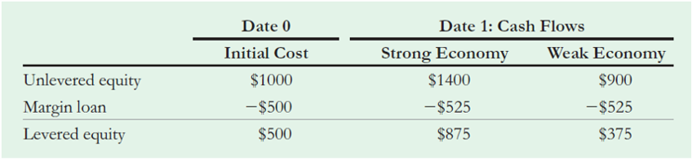
Table 6
Replicating Levered Equity Using Homemade Leverage
Notes:
Long Description:
The table headers are date 0 (initial cost) and date 1: cash flows (strong economy and weak economy). The data is listed row-wise as follows: unlevered equity, 1000 dollars, 1400 dollars, 900 dollars; margin loan, negative 500 dollars, negative 525 dollars, negative 525 dollars; levered equity, 500 dollars, 875 dollars, 375 dollars.

Slide 40
Homemade Leverage (3 of 5)
If the cash flows of the unlevered equity serve as collateral for the margin loan (at the risk−free rate of 5%), then by using homemade leverage, the investor has replicated the payoffs to the levered equity, as illustrated in the previous slide, for a cost of $500
  By the Law of One Price, the value of levered equity must also be $500

Slide 41
Homemade Leverage (4 of 5)
Now assume you use debt, but the investor would prefer to hold unlevered equity
The investor can replicate the payoffs of unlevered equity by buying both the debt and the equity of the firm
Combining the cash flows of the two securities produces cash flows identical to unlevered equity, for a total cost of $1000

Slide 42
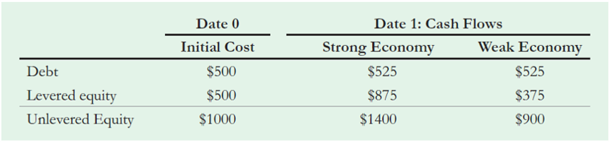
Table 7
Replicating Unlevered Equity by Holding Debt and Equity
Notes:
Long Description:
The table headers are date 0 (initial cost) and date 1: cash flows (strong economy and weak economy). The data listed row-wise are as follows: unlevered equity, 500 dollars, 525 dollars, 525 dollars; margin loan, 500 dollars, 875 dollars, 375 dollars; levered equity, 1000 dollars, 1400 dollars, 900 dollars.

Slide 43
Homemade Leverage (5 of 5)
In each case, your choice of capital structure does not affect the opportunities available to investors
  Investors can alter the leverage choice of the firm to suit their personal tastes either by adding more leverage or by reducing leverage
  With perfect capital markets, different choices of capital structure offer no benefit to investors and does not affect the value of the firm

Slide 44
Example 2 (1 of 3)
Homemade Leverage and Arbitrage
Problem
  Suppose there are two firms, each with date 1 cash flows of $1400 or $900 (as show in Table 1). The firms are identical except for their capital structure. One firm is unlevered, and its equity has a market value of $990. The other firm is levered with a market value of equity of $510. Does M M proposition I hold? What arbitrage opportunity is available using homemade leverage?

Slide 45
Example 2 (2 of 3)
Solution
M M proposition
  states that the total value of each firm should equal the
value of its assets. Because these firms hold identical assets, their total values should be the same. However, the problem assumes the unlevered firm has a total market value of $990,wheres the levered firm has a total market value of
therefore, these prices violate M M proposition
  Because these two identical firms are trading for different total prices, the Law of One price is violated and an arbitrage opportunity exists. To exploit it, we can borrow $500 and buy the equity of the unlevered firm for $990, re-creating the equity of the levered firm by using homemade
  leverage for a cost of only
  We can then sell the equity of the levered firm for $510 and enjoy an arbitrage profit of $20.

Slide 46
Example 2 (3 of 3)
Blank | Date 0 | Date 1: Cash Flows | Blank
Blank | Cash Flow | Strong Economy | Weak Economy
Borrow | $500 | −$525 | −$525
Buy unlevered equity | −$990 | $1400 | $900
Sell levered equity | $510 | −$875 | −$375
Total cash flow | $20 | $0 | $0
Note that the action of arbitrageurs buying the unlevered firm and selling the levered firm will cause price of the unlevered firm’s stock to rise and the price of the levered firm’s stock to
fall until the firms’ values are equal and M M proposition
holds.

Slide 47
The Market Value Balance Sheet (1 of 2)
Market Value Balance Sheet
  A balance sheet where:
    All assets and liabilities of the firm are included (even intangible assets such as reputation, brand name, or human capital that are missing from a standard accounting balance sheet)
    All values are current market values rather than historical costs
  The total value of all securities issued by the firm must equal the total value of the firm’s assets

Slide 48
Table 8
The Market Value Balance Sheet of the Firm
Assets | Liabilities
Collection of Assets and Investments Undertaken by the Firm: | Collection of securities Issued by the Firm:
Tangible Assets | Debt
Cash | Short-term debt
Plant, property, and equipment | Long-term debt
Inventory and other working capital (and so on) | Convertible debt
Intangible Assets | Equity
Intellectual property | Common stock
Reputation | Preferred stock
Human capital (and so on) | Warrants (options)
Total market value of Firm Assets | Total Market value of Firm Securities

Slide 49
The Market Value Balance Sheet (2 of 2)
Using the market value balance sheet, the value of equity is computed as follows:

Slide 50
Example 3 (1 of 2)
Valuing Equity When There Are Multiple Securities
Problem
  Suppose our entrepreneur decides to sell the firm by splitting it into there securities: $500 of debt, and a third security called a warrant that pays $210 when the firm’s cash flow are high and nothing when the cash flows are low. Suppose that this third security is fairly priced at $60.
  What will the value of the equity be in a perfect capital market?

Slide 51
Example 3 (2 of 2)
Solution
According to M M Proposition
  the total value of all
  securities issued should equal the value of the assets of the firm, which is $1000. Because the debt is worth $500 and the new security is worth $60, the value of the equity must be $440. (You can check this result by verifying that at this price, equity has a risk premium commensurate with its in comparison with the securities in table 5.)

Slide 52
Application: A Leveraged Recapitalization (1 of 7)
Leveraged Recapitalization
  When a firm uses borrowed funds to pay a large special dividend or repurchase a significant amount of outstanding shares

Slide 53
Application: A Leveraged Recapitalization (2 of 7)
Example:
  Harrison Industries is currently an all−equity firm operating in a perfect capital market, with 50 million shares outstanding that are trading for $4 per share
  Harrison plans to increase its leverage by borrowing $80 million and using the funds to repurchase 20 million of its outstanding shares

Slide 54
Application: A Leveraged Recapitalization (3 of 7)
Example
  This transaction can be viewed in two stages.
    First, Harrison sells debt to raise $80 million in cash.
    Second, Harrison uses the cash to repurchase shares

Slide 55
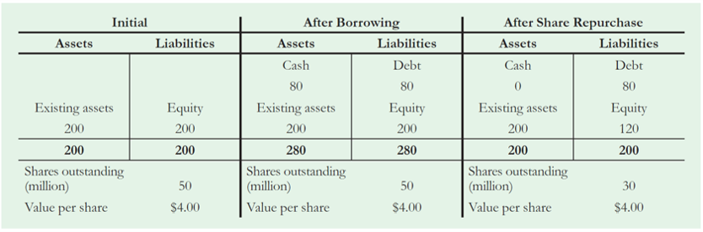
Table 9
Market Value Balance Sheet after Each Stage of Harrison’s Leveraged Recapitalization ($ millions)
Notes:
Long Description:
The table headers are assets and liabilities. The data listed row-wise are as follows: existing assets, equity; 200, 200; 200, 200; shares outstanding (million), 50; value per share, 4 dollars; cash, debt; 80, 80; existing assets, equity; 200, 200; 280, 280; shares outstanding (million), 50; value per share, 4 dollars; cash, debt; 0, 80; existing assets, equity; 200, 120; 200, 200; shares outstanding (million), 30; value per share, 4 dollars.

Slide 56
Application: A Leveraged Recapitalization (4 of 7)
Example
  Initially, Harrison is an all−equity firm and the market value of Harrison’s equity is $200 million
and equals the market value of its existing assets

Slide 57
Application: A Leveraged Recapitalization (5 of 7)
Example
  After borrowing, Harrison’s liabilities grow by $80 million, which is also equal to the amount of cash the firm has raised
  Because both assets and liabilities increase by the same amount, the market value of the equity remains unchanged

Slide 58
Application: A Leveraged Recapitalization (6 of 7)
Example
  To conduct the share repurchase, Harrison spends the $80 million in borrowed cash to repurchase 20 million shares
  Because the firm’s assets decrease by $80 million and its debt remains unchanged, the market value of the equity must also fall by $80 million, from $200 million to $120 million, for assets and liabilities to remain balanced

Slide 59
Application: A Leveraged Recapitalization (7 of 7)
Example
  The share price is unchanged
    With 30 million shares remaining, the shares are worth $4 per share, just as before

Slide 60
3 Modigliani−Miller II : Leverage, Risk, and the Cost of Capital (1 of 9)
Leverage and the Equity Cost of Capital
  M M ’s first proposition can be used to derive an explicit relationship between leverage and the equity cost of capital

Slide 61
3 Modigliani−Miller II : Leverage, Risk, and the Cost of Capital (2 of 9)
Leverage and the Equity Cost of Capital
  E
    Market value of equity in a levered firm
  D
    Market value of debt in a levered firm
  U
    Market value of equity in an unlevered firm
  A
    Market value of the firm’s assets

Slide 62
3 Modigliani−Miller II : Leverage, Risk, and the Cost of Capital (3 of 9)
Leverage and the Equity Cost of Capital
  M M Proposition
  states that
  The total market value of the firm’s securities is equal to the market value of its assets, whether the firm is unlevered or levered

Slide 63
3 Modigliani−Miller II : Leverage, Risk, and the Cost of Capital (4 of 9)
Leverage and the Equity Cost of Capital
  The cash flows from holding unlevered equity can be replicated using homemade leverage by holding a portfolio of the firm’s equity and debt

Slide 64
3 Modigliani−Miller II : Leverage, Risk, and the Cost of Capital (5 of 9)
Leverage and the Equity Cost of Capital
  The return on unlevered equity
  is related to the
  returns of levered equity
  and debt

Slide 65
3 Modigliani−Miller II : Leverage, Risk, and the Cost of Capital (6 of 9)
Leverage and the Equity Cost of Capital
  Solving for
    The levered equity return equals the unlevered return, plus a premium due to leverage
      The amount of the premium depends on the amount of leverage, measured by the firm’s
  market value debt−equity ratio,
Notes:
Long description:
R subscript E baseline equals R subscript U baseline plus start fraction D over E end fraction left parenthesis R subscript U baseline minus R subscript D baseline right parenthesis. A text below the expression R subscript U reads, risk without leverage. A text below the expression start fraction D over E end fraction left parenthesis R subscript U baseline minus R subscript D baseline right parenthesis reads, additional risk due to leverage.

Slide 66
3 Modigliani−Miller II : Leverage, Risk, and the Cost of Capital (7 of 9)
Leverage and the Equity Cost of Capital
  M M Proposition
    The cost of capital of levered equity is equal to the cost of capital of unlevered equity plus a premium that is proportional to the market value debt−equity ratio
    Cost of Capital of Levered Equity

Slide 67
3 Modigliani−Miller II : Leverage, Risk, and the Cost of Capital (8 of 9)
Leverage and the Equity Cost of Capital
  Recall from above:
    If the firm is all−equity financed, the expected return on unlevered equity is 15%
    If the firm is financed with $500 of debt, the expected return of the debt is 5%

Slide 68
3 Modigliani−Miller II : Leverage, Risk, and the Cost of Capital (9 of 9)
Leverage and the Equity Cost of Capital
  Therefore, according to M M Proposition
  the expected return on equity for the levered firm is

Slide 69
Example 4 (1 of 2)
Computing the Equity Cot of Capital
Problem
  Suppose the entrepreneur of section 1 borrow only $200 when financing the project. According to M M
  Proposition
  what will be the firm’s equity cost of
  capital?

Slide 70
Example 4 (2 of 2)
Solution
Because the firm’s assets have a market value of $1000,
  by M M Proposition
  the equity will have a market value
  of $800. Then using last equation :
This result matches the expected return calculate in Example 1.

Slide 71
Capital Budgeting and the Weighted Average Cost of Capital (1 of 4)
If a firm is unlevered, all of the free cash flows generated by its assets are paid out to its equity holders
  The market value, risk, and cost of capital for the firm’s assets and its equity coincide and therefore

Slide 72
Capital Budgeting and the Weighted Average Cost of Capital (2 of 4)
If a firm is levered, project
is equal to the firm’s weighted
average cost of capital
  Unlevered Cost of Capital (Pretax W A C C)
Notes:
Long description:
r subscript w a c c baseline equals left parenthesis fraction of firm value financed by equity right parenthesis left parenthesis equity cost of capital right parenthesis plus left parenthesis fraction of firm value financed by debt right parenthesis left parenthesis debt cost of capital right parenthesis. Equals start fraction upper E over upper E plus upper D end fraction r subscript upper E baseline plus start fraction upper D over upper E plus upper D end fraction r subscript upper D.

Slide 73
Capital Budgeting and the Weighted Average Cost of Capital (3 of 4)
With perfect capital markets, a firm’s W A C C is independent of its capital structure and is equal to its equity cost of capital if it is unlevered, which matches the cost of capital of its assets
Debt−to−Value Ratio
  The fraction of a firm’s enterprise value that corresponds to debt

Slide 74
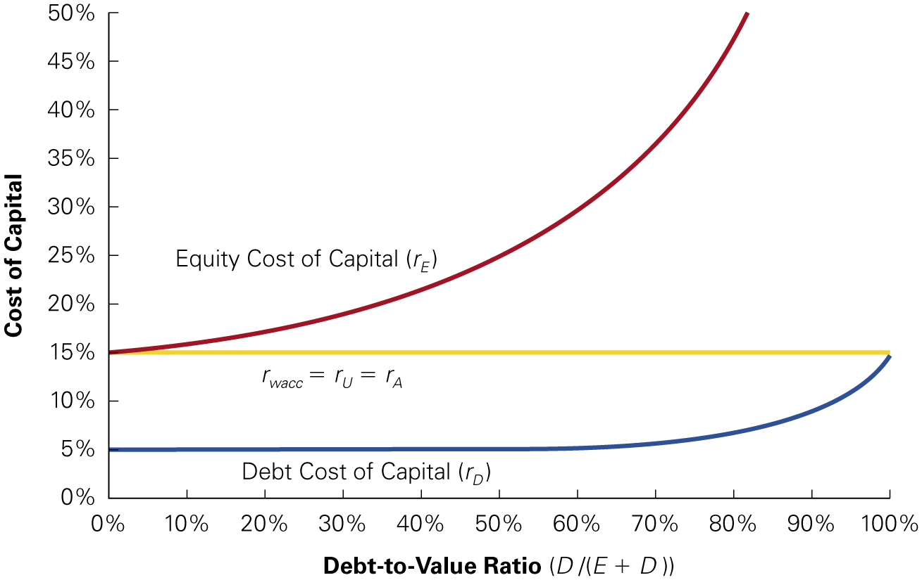
Figure 1
W A C C and Leverage with Perfect Capital Markets
(a) Equity, debt, and weighted average costs of capital for leverage. The rate of increase
of
and
  and thus the
shape of the curves, depends on the characteristics of the firm’s cash flows.
(b) Calculating the W A C C for alternative capital structures. Data in this table correspond to the example in Section 1.
E | D | r subscript upper E. | r subscript upper D. | start fraction upper E over upper E plus upper D end fraction r subscript upper E baseline plus start fraction upper D over upper E plus upper D end fraction r subscript upper D baseline | Equals r subscript w a c c baseline
1000 | 0 | 15 point % | 5 point 0 % | 1 point 0 multiply 15 point 0 % plus 0 point 0 multiply 5 point 0 % | = 15%
800 | 200 | 17 point 5 % | 5 point 0 % | 0 point 8 multiply 17 point 5 % plus 0 point 2 multiply 5 point 0 % | = 15%
500 | 500 | 25 point 0 % | 5 point 0 % | 0 point 5 multiply 25 point 0 % plus 0 point 5 multiply 5 point 0 % | = 15%
100 | 900 | 75 point 0 % | 8 point 3 % | 0 point 1 multiply 75 point 0 % plus 0 point 9 multiply 8 point 3 % | = 15%
Notes:
Long Description:
The x-axis shows the debt-to-value ratio D over left parenthesis E plus D right parenthesis ranging from 0 to 100 in increments of 10. The y-axis represents the cost of capital ranging from 0 to 50 in increments of 5. A straight line parallel to the x-axis is at 15 percent which represents r sub W A C C equals r sub u equals r sub a. equity cost of the capital curve starts from (0 comma 15 percent) and rises till (80 comma 50 percent). The Debt Cost of Capital (r sub D) is a flatter curve that starts from (0 comma 5 percent) and ends at (100 comma 15 percent).

Slide 75
Capital Budgeting and the Weighted Average Cost of Capital (4 of 4)
With no debt, the W A C C is equal to the unlevered equity cost of capital
As the firm borrows at the low cost of capital for debt, its equity cost of capital rises. The net effect is that the firm’s W A C C is unchanged

Slide 76
Example 5 (1 of 3)
Reducing Leverage and the Cost of Capital
Problem
  N R G Energy, Inc. (N R G) is an energy company with a market debt-equity ratio of 2. Suppose its current debt cost of capital is 6%, and its equity cost of capital is 12%. Suppose also that if N R G issues equity and uses the proceeds to repay its junior debt and reduce its debt-equity ratio to 1, it will lower its debt cost of capital to 5.5%. With perfect capital markets, what effect will this transaction have on N R G’s equity cost of capital and W A C C? What would happen if N R G issues even more equity and pays off its debt completely? How would these alternative capital structures affect N R G’s enterprise value?

Slide 77
Example 5 (2 of 3)
Solution
We can calculate N R G’s initial W A C C and unlevered cost of capital using Equations :
Given N R G’s unlevered cost of capital of 8%, we can use Equation to calculate N R G’s equity cost of capital after the reduction in leverage:
Notes:
Long description 1:
r subscript upper W upper A upper C upper C baseline equals r subscript upper U baseline equals start fraction upper E over upper E plus upper D end fraction r subscript upper E baseline plus start fraction upper D over upper E plus upper D end fraction r subscript upper D baseline equals start fraction 1 over 1 plus 2 end fraction left parenthesis 12 percent right parenthesis plus start fraction 2 over 1 plus 2 end fraction left parenthesis 6 percent right parenthesis equals 8 percent.
Long description 2:
r subscript upper E baseline equals r subscript upper U plus start fraction upper D over upper E end fraction left parenthesis r subscript upper U baseline minus r subscript upper D baseline right parenthesis equals 8 percent plus start fraction 1 over 1 end fraction left parenthesis 8 percent minus 5.5 percent right parenthesis equals 10.5 percent.

Slide 78
Example 5 (3 of 3)
The reduction in leverage will cause N R G’s equity cost of capital to fall to 10.5%. Note though, that with perfect capital markets, N R G’s W A C C remain unchanged at
and there is no net gain from this transaction.
  If N R G pays off its debt completely, it will be unlevered. Thus, its equity cost of capital will equal its W A C C and unlevered cost of capital of 8%.
  In either scenario, N R G’s W A C C and free cash flows remain unchanged. Thus, with perfect capital markets, its enterprise value will not be affected by these different capital structure choices.
Notes:
Long description:
r subscript upper E baseline equals r subscript upper U plus start fraction upper D over upper E end fraction left parenthesis r subscript upper U baseline minus r subscript upper D baseline right parenthesis equals 8 percent equals one-half left parenthesis 10.5 percent right parenthesis plus one-half left parenthesis 5.5 percent right parenthesis comma.

Slide 79
Computing the W A C C with Multiple Securities
If the firm’s capital structure is made up of multiple securities, then the W A C C is calculated by computing the weighted average cost of capital of all of the firm’s securities

Slide 80
Example 6 (1 of 3)
W A C C with Multiple Securities
Problem
  Compute the W A C C for the entrepreneur’s project with the capital structure described in Example 3.

Slide 81
Example 6 (2 of 3)
Solution
Because the firm has three securities in its capital structure (debt, equity, and the warrant), its weighted average cost of capital is the average cost of capital is the average return in must pay these three group of investors:
From Example 3, we know
What are the expected returns for each security? Given the cash flows of the firm,
the debt is risk free and has an expected return of
The warrant has an
expected payoff of
so its expected return is
Equity has a payoff of
  when cash flows are low; thus its
  expected payoff is
  The expected return for equity is then
Notes:
Long description:
r subscript w a c c baseline equals r subscript upper U baseline equals start fraction upper E over upper E plus upper D plus upper W end fraction r subscript upper E baseline plus start fraction upper D over upper E plus upper D plus upper W end fraction r subscript upper D plus start fraction upper W over upper E plus upper D plus upper W end fraction r subscript upper W.

Slide 82
Example 6 (3 of 3)
We can now compute the W A C C:
Once again, the firm’s W A C C and unlevered cost of capital is 15%, the same as if were all equity financed.
Notes:
Long description:
r subscript w a c c baseline equals start fraction 440 dollars over 1000 dollars end fraction left parenthesis 18.18 percent right parenthesis plus start fraction 500 dollars over 1000 dollars end fraction left parenthesis 5 percent right parenthesis plus start fraction 60 dollars over 1000 dollars end fraction left parenthesis 75 percent right parenthesis equals 15 percent.

Slide 83
Levered and Unlevered Betas (1 of 3)
The effect of leverage on the risk of a firm’s securities can also be expressed in terms of beta:

Slide 84
Levered and Unlevered Betas (2 of 3)
Unlevered Beta
  A measure of the risk of a firm as if it did not have leverage, which is equivalent to the beta of the firm’s assets
If you are trying to estimate the unlevered beta for an investment project, you should base your estimate on the unlevered betas of firms with comparable investments

Slide 85
Levered and Unlevered Betas (3 of 3)
Leverage amplifies the market risk of a firm’s assets,
raising the market risk of its equity

Slide 86
Example 7 (1 of 2)
Betas and Leverage
Problem
  Suppose drug retailer C V S has an equity beta of
  and a debt beta is zero. Suppose C V S were to increase its leverage so that its debt−equity ratio was
  Assuming its debt beta were still zero, what would
  you expect its equity beta to be after the increase in leverage?

Slide 87
Example 7 (2 of 2)
Solution
We can estimate the unlevered or asset beta for C V S using equation :
With the increase in leverage, C V S’s equity beta will increase according to equation:
Thus, C V S’s equity beta (and equity cost of capital) will increase with leverage. Note that if C V S’s debt beta increased, the impact of leverage on its equity beta would be somewhat lower―if debt holders share some of the firm’s market risk, the equity holders will need to bear less of it.
Notes:
Long description 1:
Beta subscript U baseline equals start fraction E over E plus D end fraction beta subscript E baseline plus start fraction D over D plus E end fraction beta subscript D baseline equals start fraction 1 over 1 plus start fraction D over E end fraction end fraction beta subscript E baseline equals start fraction 1 over 1 plus 0.1 end fraction times 0.8 equals 0.73.
Long description 2:
Beta subscript E baseline equals beta subscript U baseline plus start fraction D over E end fraction left parenthesis beta subscript U baseline minus beta subscript D baseline right parenthesis equals 0.73 plus 0.5 left parenthesis 0.73 minus 0 right parenthesis equals 1.09.

Slide 88
Example 8 (1 of 2)
Cash and the Cost of Capital
Problem
  In March 2022, Cisco Systems had a market capitalization of $230 billion. It had debt of $12 billion as we as cash and short−term investment of $25 billion. Its equity beta was 0.95 and its debt was approximately zero. What was Cisco’s enterprise value at time? Given a risk−free rate of 2.75% and a market risk premium of 5%, estimate the unlevered cost of capital of Cisco’s business.

Slide 89
Example 8 (2 of 2)
Solution
Because Cisco had $12 billion in debt and $25 billion in cash. Cisco’s net debt
Its enterprise value was therefore
Given a zero beta its net debt, Cisco’s unlevered beta was
and we can estimate its unlevered cost of capital as
Note that because of its cash holdings, Cisco’s equity is less risky than its underlying business.
Notes:
Long description:
Beta subscript U baseline equals start fraction E over E plus D end fraction beta subscript E baseline plus start fraction D over E plus D end fraction beta subscript D equals start fraction 230 dollars over 217 dollars end fraction left parenthesis 0.95 right parenthesis plus start fraction negative 13 over 217 dollars end fraction left parenthesis 0 right parenthesis equals 1.01.

Slide 90
4 Capital Structure Fallacies (1 of 5)
Leverage and Earnings per Share
  Example
    L V I is currently an all−equity firm. It expects to generate earnings before interest and taxes (E B I T) of $10 million over the next year
    Currently, L V I has 10 million shares outstanding,
    and its stock is trading for a price of
    per
    share
    L V I is considering changing its capital structure by borrowing $15 million at an interest rate of 8% and
    using the proceeds to repurchase 2 million shares at
    per share

Slide 91
4 Capital Structure Fallacies (2 of 5)
Leverage and Earnings per Share
  Example
    Suppose L V I has no debt. Because there is no interest and no taxes, L V I’s earnings would equal its E B I T and L V I’s earnings per share without leverage would be

Slide 92
4 Capital Structure Fallacies (3 of 5)
Leverage and Earnings per Share
  Example
    If L V I recapitalizes, the new debt will obligate L V I to make interest payments each year of $1.2 million/year
    As a result, L V I will have expected earnings after interest of $8.8 million

Slide 93
4 Capital Structure Fallacies (4 of 5)
Leverage and Earnings per Share
  Example
    Earnings per share rises to
    L V I’s expected earnings per share increases with leverage

Slide 94
4 Capital Structure Fallacies (5 of 5)
Leverage and Earnings per Share
  Example
    Are shareholders better off?
      NO! Although L V I’s expected E P S rises with leverage, the risk of its E P S also increases
      While E P S increases on average, this increase is necessary to compensate shareholders for the additional risk they are taking, so L V I’s share price does not increase as a result of the transaction

Slide 95
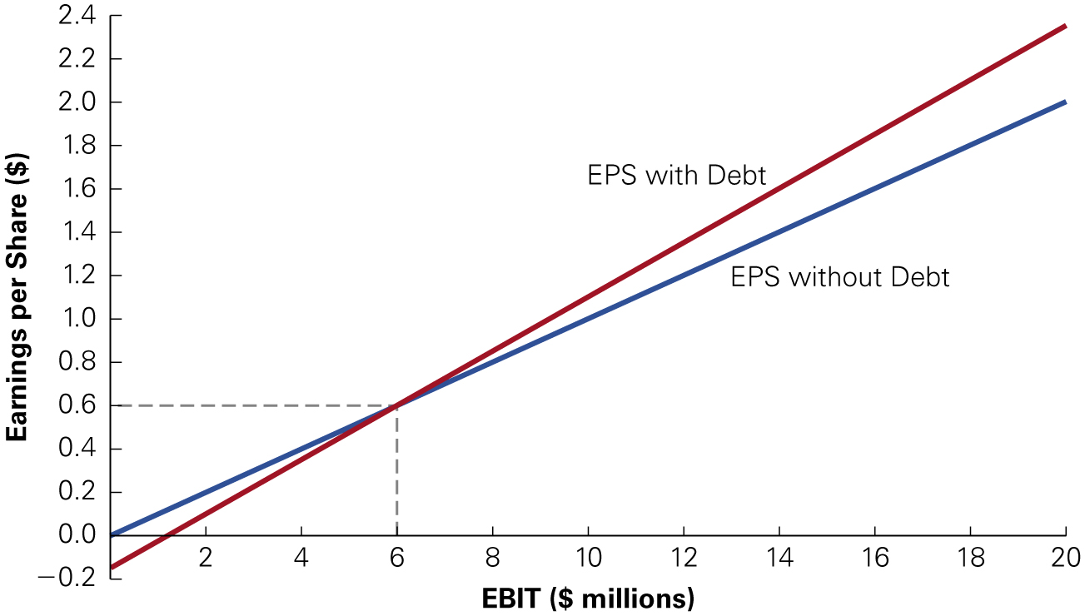
Figure 2
L V I Earnings per Share with and Without Leverage
Notes:
Long Description:
The x-axis shows E B I T (million dollars) ranging from 0 to 20 in increments of 2. The y-axis represents the cost of capital ranging from 0 to 2.4 in increments of 0.2. A straight line depicts E P S without debt starting from (0.0 comma 0.0) and ending at (20 comma 1.8). Another straight line depicts E P S with Debt starting from (0.0 comma negative 0.2) and ending at (20 comma 2.4). These two lines meet at (6 comma 0.6).

Slide 96
Example 9 (1 of 3)
The M M Propositions and Earnings per Share
Problem
  Assume that L V I’s E B I T is not expected to grow in the future and that all earnings are paid as dividends.
  Use M M proposition
  and
to show that the
  increase in expected E P S for L V I will not lead to an increase in the share price.

Slide 97
Example 9 (2 of 3)
Solution
Without leverage, expected earnings per share and therefore dividends are $1
each year, and the share price
Let r be L V I’s cost of capital without
leverage. Then we can value L V I as a perpetuity:
Therefore, L V I’s current share price implies
The market value of L V I stock without leverage
is
If L V I uses debt to repurchase $15 million worth of the firm’s equity (that is, 2 million shares), then the remaining equity will be worth
  according to M M proposition
  After the
  transaction, L V I ’s debt−equity ratio is
Using M M
  proposition
  L V I’s equity cost of capital with leverage will be

Slide 98
Example 9 (3 of 3)
  Given that expected E P S is now
  per share, the
  new value of the shares equals
Thus, even though E P S is higher, due to the additional risk, shareholders will demand a higher return. These effects cancel out, so the price per share is unchanged.
Notes:
Long description:
r subscript upper E baseline equals r subscript upper U plus start fraction upper D over upper E end fraction left parenthesis r subscript upper U baseline minus r subscript upper D baseline right parenthesis equals 13.33 plus start fraction one-fourth left parenthesis 13.33 percent minus 8 percent right parenthesis equals 14.66 percent.

Slide 99
Equity Issuances and Dilution (1 of 6)
Dilution
  An increase in the total of shares that will divide a fixed amount of earnings
It is sometimes (incorrectly) argued that issuing equity will dilute existing shareholders’ ownership, so debt financing should be used instead

Slide 100
Equity Issuances and Dilution (2 of 6)
Suppose Jet Sky Airlines (J S A) currently has no debt and 500 million shares of stock outstanding, which is currently trading at a price of $16
Last month the firm announced that it would expand and the expansion will require the purchase of $1 billion of new planes, which will be financed by issuing new equity

Slide 101
Equity Issuances and Dilution (3 of 6)
The current (prior to the issue) value of the equity and the assets of the firm is $8 billion
Suppose J S A sells 62.5 million new shares at the current price of $16 per share to raise the additional $1 billion needed to purchase the planes

Slide 102
Equity Issuances and Dilution (4 of 6)
Assets in ($ million) | Before Equity Issue | After Equity Issue
Cash | Blank | 1000
Existing assets | 8000 | 8000
Total Value | 8000 | 9000
Shares outstanding (million) | 500 | 562.5
Value per share | 16 point 00 dollars. | 16 point 00 dollars.

Slide 103
Equity Issuances and Dilution (5 of 6)
Results
  The market value of J S A’s assets grows because of the additional $1 billion in cash the firm has raised
  The number of shares increases
    Although the number of shares has grown to 562.5 million, the value per share is unchanged at $16 per share

Slide 104
Equity Issuances and Dilution (6 of 6)
As long as the firm sells the new shares of equity at a fair price, there will be no gain or loss to shareholders associated with the equity issue itself
Any gain or loss associated with the transaction will result from the N P V of the investments the firm makes with the funds raised

Slide 105
5 M M: Beyond the Propositions
Conservation of Value Principle for Financial Markets
  With perfect capital markets, financial transactions neither add nor destroy value, but instead represent a repackaging of risk (and therefore return)
    This implies that any financial transaction that appears to be a good deal may be exploiting some type of market imperfection

Slide 106
Chapter Quiz (1 of 2)
How does the risk and cost of capital of levered equity compare to that of unlevered equity? Which is the superior capital structure choice in a perfect capital market?
What is a market value balance sheet?
In a perfect capital market, how will a firm’s market capitalization change if it borrows in order to repurchase shares? How will its share price change?

Slide 107
Chapter Quiz (2 of 2)
With perfect capital markets, as a firm increases its leverage, how does its debt cost of capital change? Its equity cost of capital? Its weighted average cost of capital?
If a change in leverage raises a firm’s earnings per share, should this cause its share price to rise in a perfect market?
Consider the questions facing Dan Harris, C F O of E B S, at the beginning of this chapter. What answers would you give based on the Modigliani−Miller Propositions? On what considerations should the capital structure decision be based?

